Slide 1
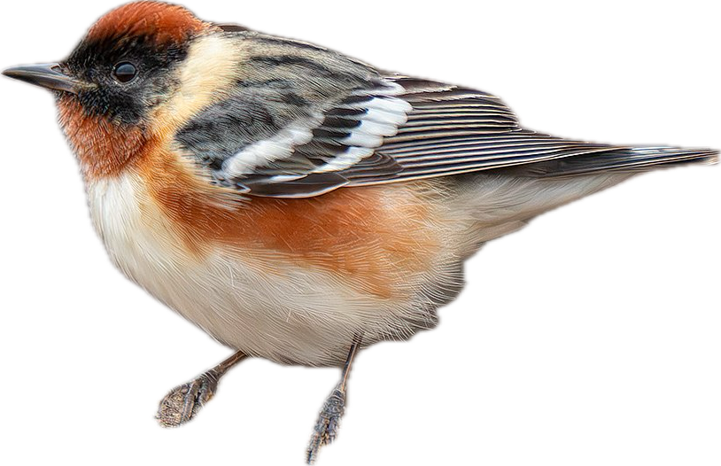
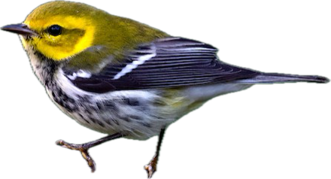
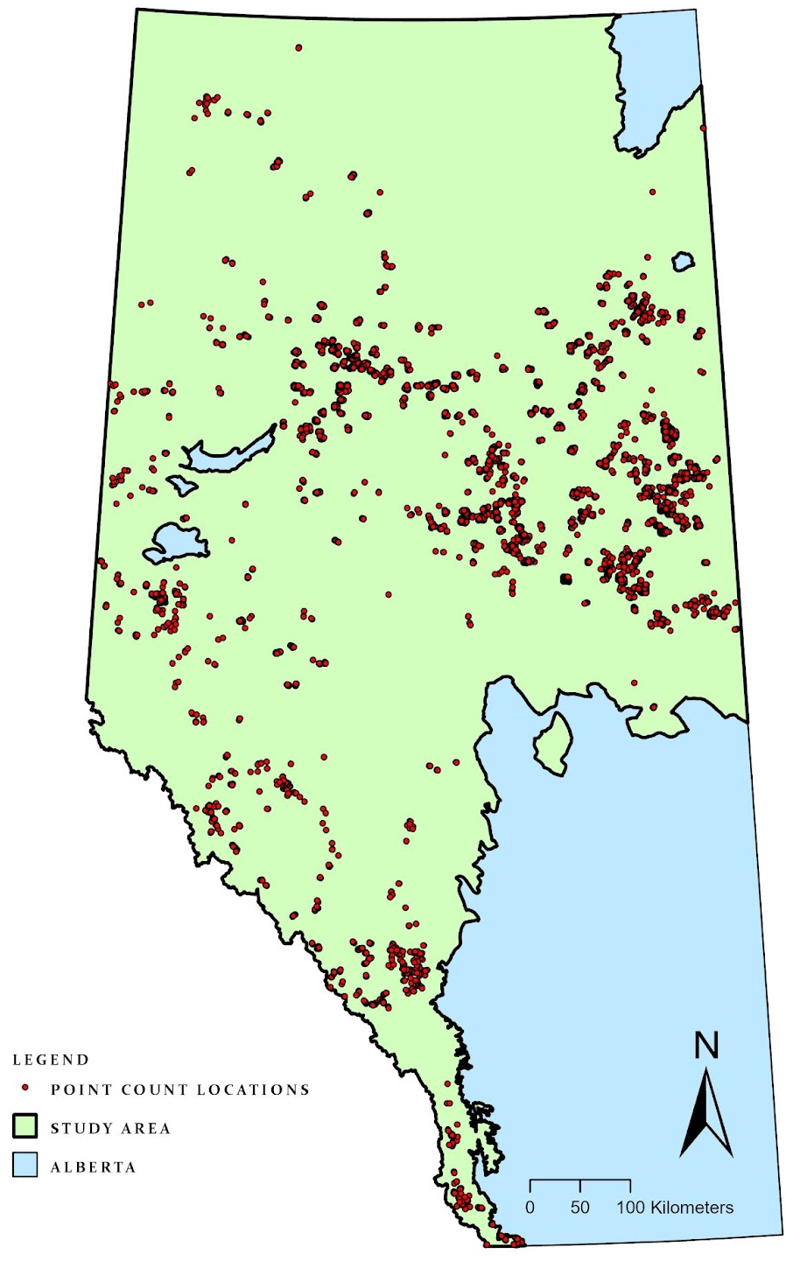
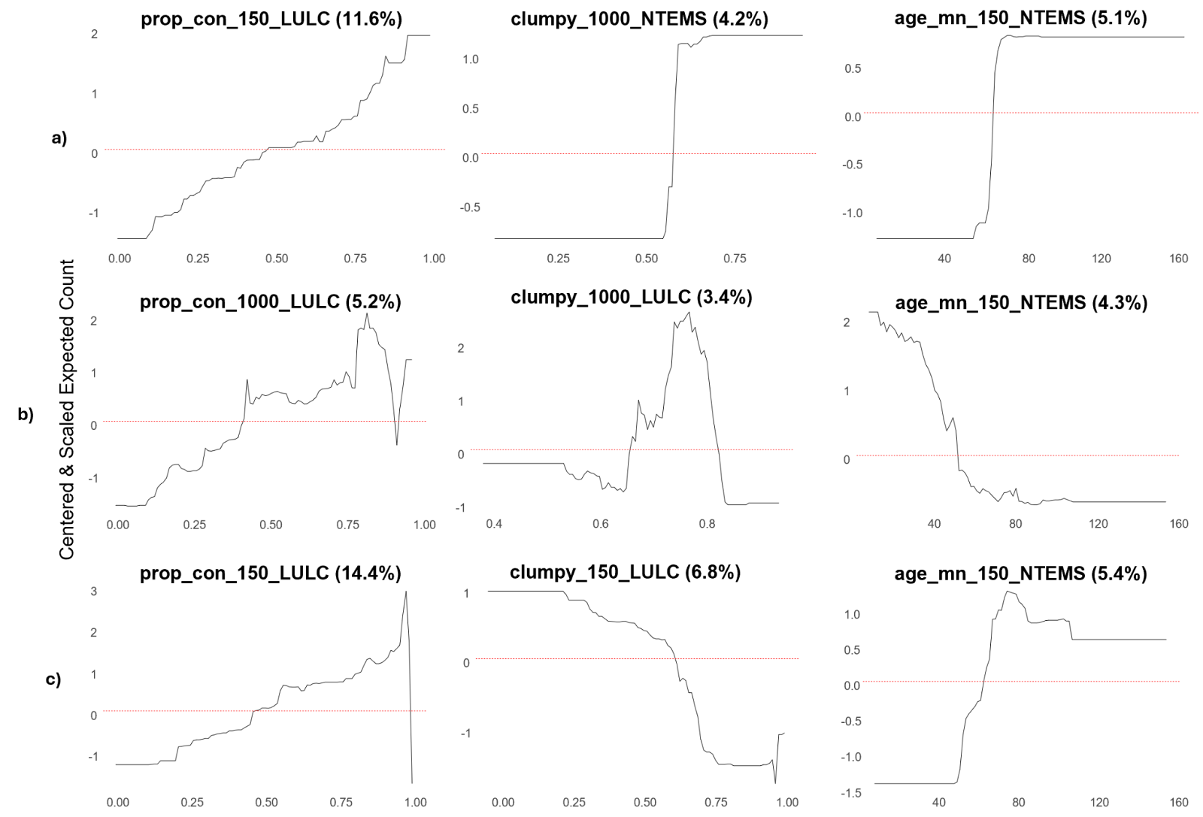
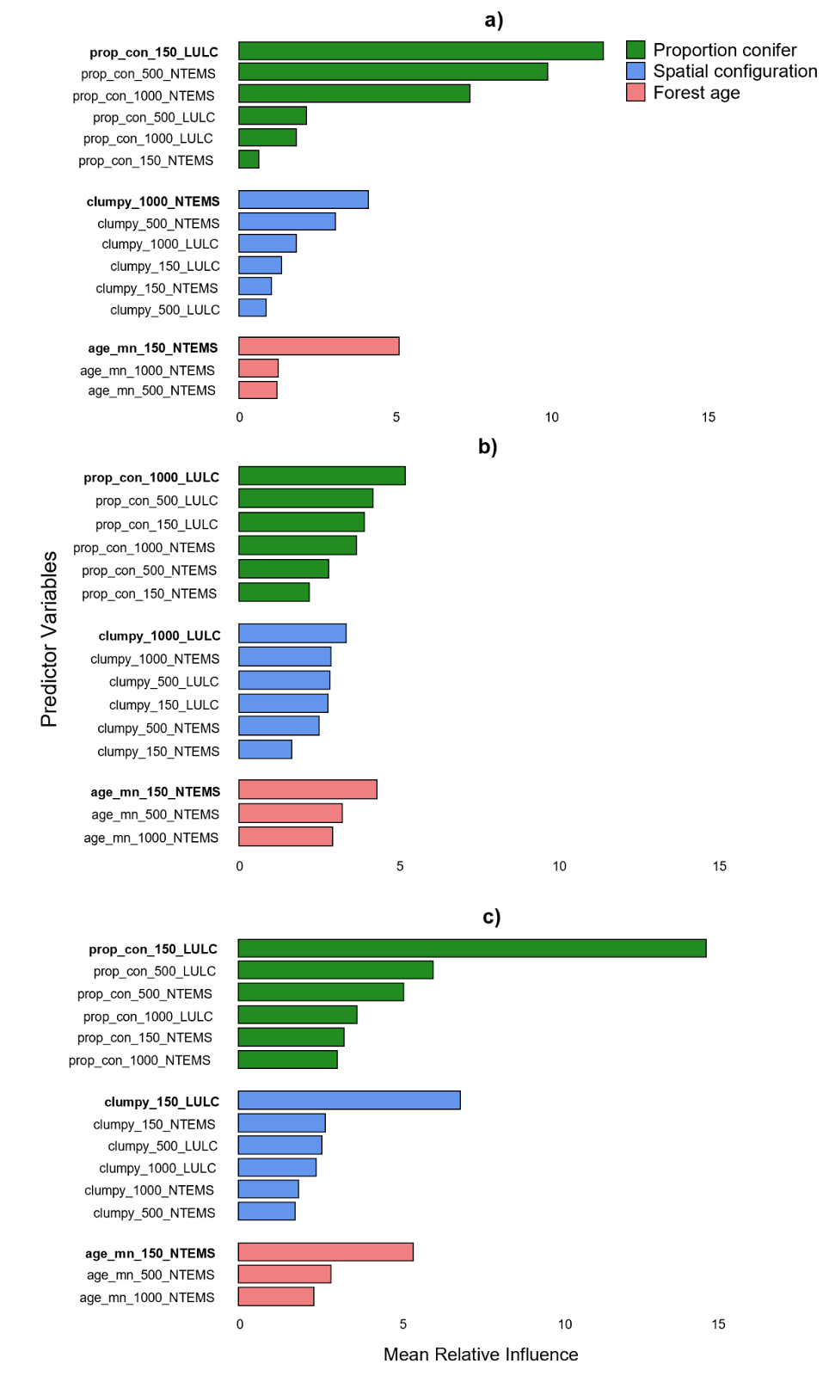
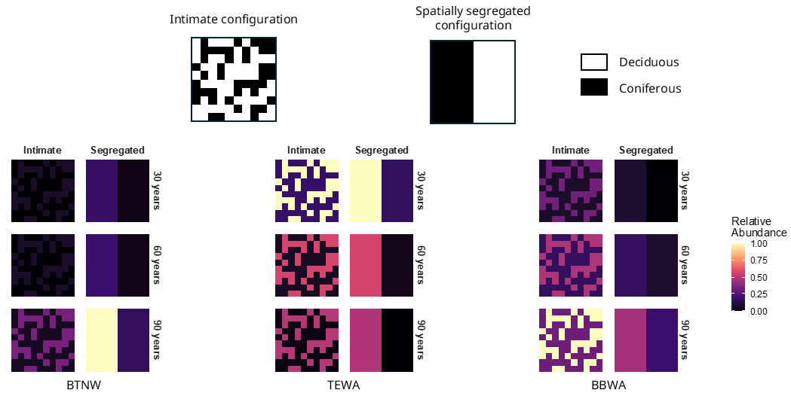
Is it a mixedwood? Spatially-explicit responses to gradients in habitat structure and composition in three boreal bird species
Leonard Patterson (M.Sc. Student), Brendan Casey (ABMI), Dr. Erin Bayne (Supervisor)
Department of Biological Sciences, University of Alberta
Contact: ljpatter@ualberta.ca
Background and Objectives
Results (continued)
Conventional definitions of boreal mixedwood forests are based solely on tree species composition, consider species composition at a relatively coarse grain, and do not explicitly address spatial scale. Such definitions may oversimplify the habitat complexity perceived by avian species, potentially biasing past attempts to identify mixedwood habitat associations. In the absence of a clear understanding of which structural and compositional components make mixedwood forests suitable habitat for boreal birds, intimate mixedwood forests are increasingly being replaced with spatially segregated mixedwood forests, without knowing whether these configurations provide equivalent ecological value to boreal birds. Given the ongoing decline of many boreal bird species, understanding and defining mixedwood forests from a bird’s perspective is important for understanding the consequences of current harvesting and reforestation practices.
The proportion of conifer emerged as the most influential predictor for all three species (Figure 1), with relative abundance increasing with the proportion of conifer (Figure 2). Spatial configuration had the second highest relative influence among scale of effect predictors for bay-breasted warbler (BBWA), and the lowest for black-throated green (BTNW) and Tennessee warbler (TEWA). Notably, BBWA responded most strongly to local extent and fine grain measurements of spatial configuration, with relative abundance decreasing with increasing aggregation. Forest age was the second most important predictor for BTNW and TEWA, and the least important predictor for BBWA. TEWA abundance decreased with increasing forest age, suggesting that TEWA prefers early-successional mixedwood forests.
Across all species, the strength and even the direction of habitat associations varied with spatial scale and grain. Finer grain sizes were generally more informative for BBWA and TEWA, whereas BTNW showed strong responses at both grain sizes depending on the predictor. The 150 m extent consistently emerged as the scale of effect across predictors. BBWA is the only species that consistently responded most strongly to local extent and fine grain size habitat measurements.
Methods
We used a boosted regression tree model to understand how the abundance of black-throated green warbler (Setophaga virens), Tennessee warbler (Leiothlypis peregrina), and bay-breasted warbler (Setophaga castanea) changed along a gradient of deciduous-coniferous composition, spatial configuration of conifer, and forest age measured at three extents—a local (150 m), intermediate (500 m), and broad (1000 m) extent—and two grain sizes—fine (10 m² (LULC)) and coarse (30 m² (NTEMS)) grain. At each extent and grain, we quantified forest composition as the proportion of coniferous tree species, spatial configuration of the coniferous-deciduous mixture using the Clumpiness Index (CLUMPY), and forest age as the mean forest.
We used an existing point count dataset consisting of 8625 human and autonomous recording unit (ARU) points counts conducted between 2009 and 2024 across the Rocky Mountain, Foothills, and Boreal Forest Natural Regions of Alberta.
Results
Figure 2. Partial dependence plots showing the marginal effect of each scale of effect predictor on the raw expected count, based on the final BRT model for black-throated green warbler (a), Tennessee warbler (b), and bay-breasted warbler (c). The x-axis represents the range of values for each scale of effect predictor and the y-axis represents the standardized expected count. Red dashed lines indicate the centered average effect (i.e., no net change in abundance).
Figure 3. Predicted relative abundance for black-throated green warbler (BTNW), Tennessee warbler (TEWA), and bay-breasted warbler (BBWA) in synthetic intimate and spatially aggregated mixedwood forest configurations at three forest age classes. Top panels illustrate the two synthetic mixedwood configurations containing equal coniferous and deciduous pixels: an intimate layout (left)(CLUMPY ≈ 0) and a spatially segregated layout (right)(CLUMPY ≈ 1). Predictions were made using scale of effect predictors. Relative abundance predictions are scaled between 0 (low relative abundance) to 1 (high relative abundance).
Predictions across synthetic intimate and spatially-segregated mixedwoods show that BTNW relative abundance increased with age and was highest in areas with aggregated conifer, suggesting that BTNW may respond more positively to habitat that is dominated by old, spatially aggregated coniferous trees; TEWA relative abundance also increased with increasing proportion of conifer but decreased with increasing forest age, suggesting that TEWA prefers young, conifer-dominated mixedwoods; BBWA relative abundance increased with forest age and decreased with increasing levels of aggregation, suggesting that BBWA prefer mature, conifer-dominated intimate mixedwood forests (Figure 3).
Conclusion and Implications
Our results underscore the need for species-specific, spatially explicit definitions of mixedwood forests. Relying solely on coarse classifications of stand composition may obscure important variation in how birds perceive and use habitat. Current reforestation policies in Alberta that mandate maintaining conifer proportions post-harvest, but do not address spatial configuration, risk unintentionally degrading habitat for mixedwood-associated species. Practices such as the free-to-grow standard may exacerbate this issue by encouraging conifer-dominated patches that are spatially segregated from deciduous components (Lieffers et al. 2008). Our findings suggest that preserving or restoring intimate mixtures of conifer and deciduous species at fine spatial scales may be particularly beneficial for species like bay-breasted warbler, which exhibit strong scale-dependent responses to spatial configuration.
Figure 1. Relative influence (%) of predictor variables averaged across 25 bootstrapped boosted regression tree models explaining the relative abundance of black-throated green warbler (a), Tennessee warbler (b), and bay-breasted warbler (c). Scale of effect predictors are in bold. LULC and NTEMS represent a 10 m² and 30 m² grain size, respectively. Prop_con, clumpy, and age_mn represent the proportion of conifers, spatial configuration, and mean forest age, respectively.

